Slide 1

React
#3 Learn Once, Write Anywhere

Slide 2

API
API (Application Programming Interface) is a software intermediary which allows applications to talk to each other.
When you use an application on your mobile phone, the application connects to the Internet and sends data to a server. The server then retrieves that data, interprets it, performs the necessary actions and sends it back to your phone. The application then interprets that data and presents to you with the information that you wanted, in a readable way. This is what an API is - all of this happens via API.

Slide 3
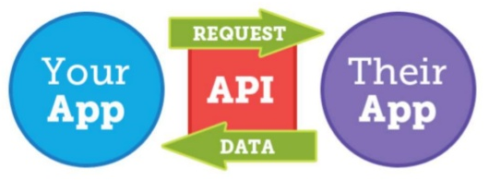
API

Slide 4
HTTP Methods
HTTP (The Hypertext Transfer Protocol) is designed to enable communications between clients & servers. It works as a request & response protocol between a client & server.
A web browser may be the client, and an application on a computer that hosts a web site may be the server.
The most commonly used HTTP Methods are POST, GET, PUT, PATCH & DELETE.

Slide 5
RESTful APIs
RESTful (Representational State Transfer) web services is a way of providing interoperability between computer system on the internet.
A RESTful API is an application program interface that uses HTTP requests to GET, PUT, POST or UPDATE data, based on representational state transfer (RESTful) architecture technology.

Slide 6
J S O N
JSON (Javascript Object Notation) is a lightweight data-interchange format that based on a subset of JS. It’s easy to read, write and can be used with any modern language. JSON is not a JavaScript Object!
JSON rules:
Uses property/value pairs = {"nama" : "Andi"}
Uses dblquote on its prop & val (ex number)
Must use specified data type
File type is ".json"
Mime type is "application/json"

Slide 7
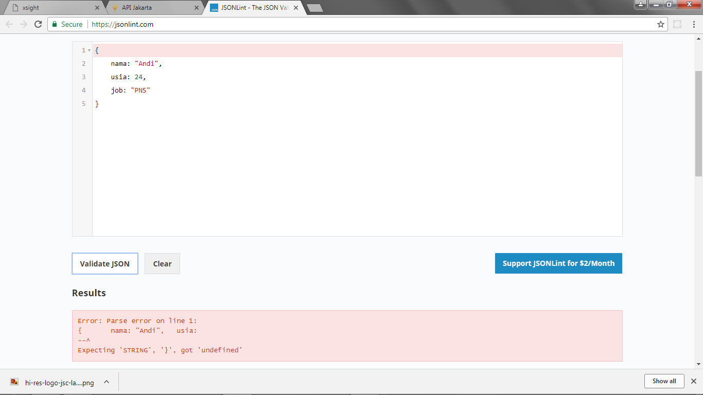
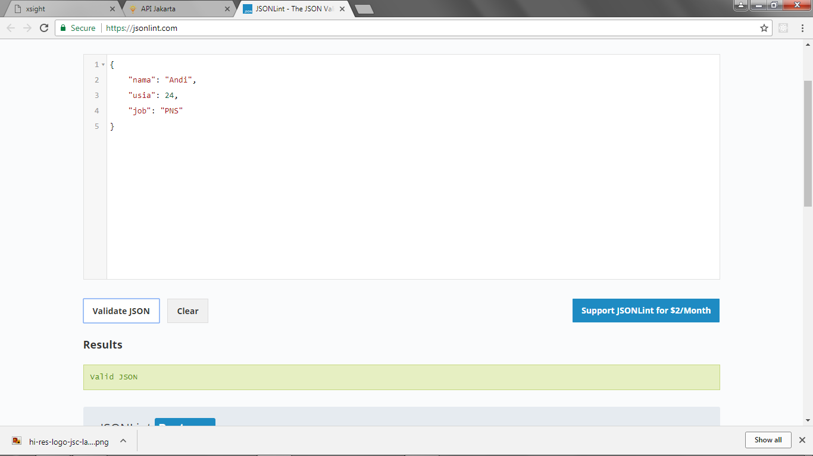
Validate JSON
jsonlint.com

Slide 8
Object → JSON
var orang = {
nama: "Andi",
usia: 21,
asal: "Lampung"
}
orang = JSON.stringify(orang);
console.log(orang);
console.log(orang.nama);

Slide 9
JSON → Object
var orang = {
nama: "Andi",
usia: 21,
asal: "Lampung"
}
orang = JSON.stringify(orang);
orang = JSON.parse(orang);
console.log(orang);
console.log(orang.nama);

Slide 10

A powerful GUI platform to make API development faster & easier, from building API requests through testing, documentation & sharing.
Postman has features for every API developer: request building, tests & pre-request scripts, variables, environments & request descriptions, designed to work seamlessly together.
Download from getpostman.com

Slide 11

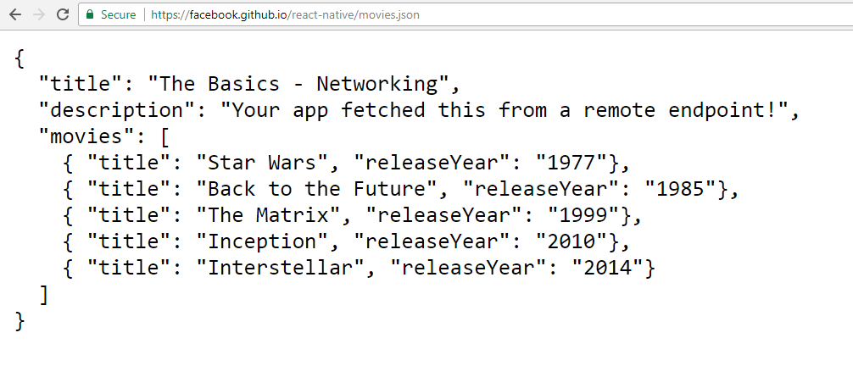

GET all data from
https://facebook.github.io/react-native/movies.json
Try on Postman!

Slide 12
Using Axios Package
Axios is an NPM built-in package that allows us to:
Make http requests from node.js
Supports the Promise API
Intercept request and response
Transform request and response data
Cancel requests
Automatic transforms for JSON data
Install Axios package:
$ npm install axios --save

Slide 13
import React, { Component } from 'react';
import axios from 'axios';
class App extends Component {
componentDidMount(){
axios.get('https://facebook.github.io/react-native/movies.json')
.then((ambilData) => {
console.log(ambilData);
})
};
render() {
return (
<div>
<h1>Coba Get Data</h1>
</div>
);
}
}
export default App;
Axios
#1 Get All Data

Slide 14
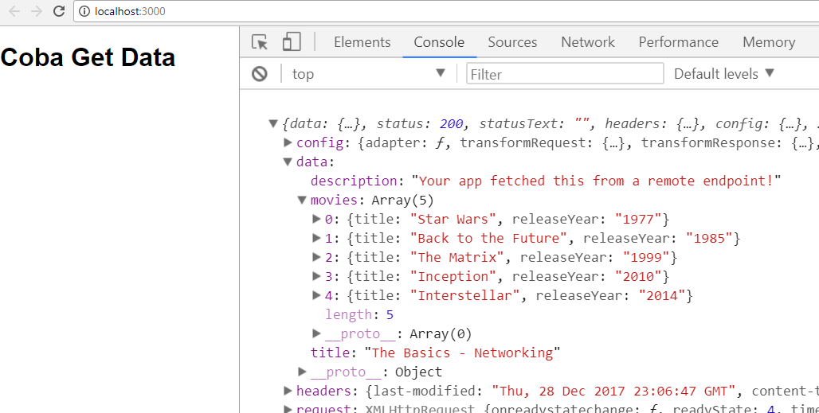
Axios
#1 Get All Data

Slide 15
import React, { Component } from 'react';
import axios from 'axios';
class App extends Component {
componentDidMount(){
axios.get('https://facebook.github.io/react-native/movies.json')
.then((ambilData) => {
console.log(ambilData.data.title);
console.log(ambilData.data.description);
console.log(ambilData.data.movies);
})
};
render() {
return (
<div>
<h1>Coba Get Data</h1>
</div>
);
}
}
export default App;
Axios
#2 Get Specific Data

Slide 16
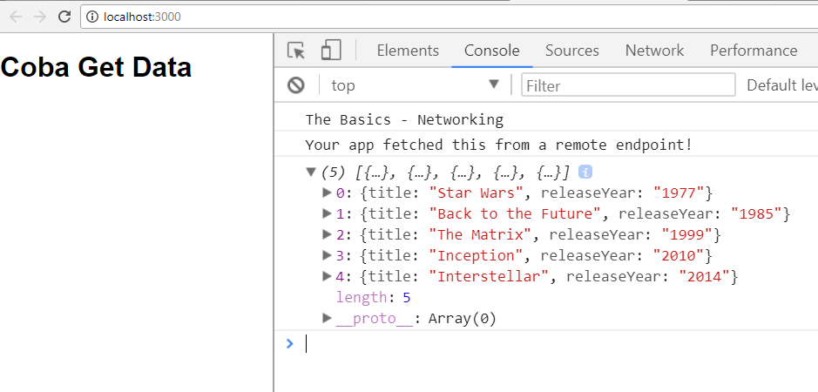
Axios
#2 Get Specific Data

Slide 17
Axios
#3 Axios API
axios.get('https://URL.json')
.then((ambilData) => {
console.log(ambilData.data.title);
console.log(ambilData.data.description);
console.log(ambilData.data.movies);
})
};
================================ Can be written as
axios({
url: 'https://URL.json',
method: 'GET',
}).then((ambilData) => {
console.log(ambilData.data.title);
console.log(ambilData.data.description);
console.log(ambilData.data.movies);
})

Slide 18
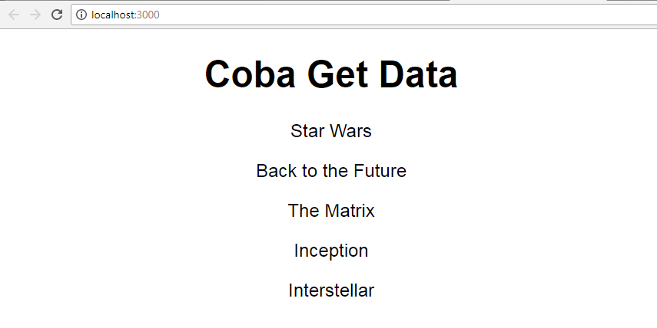
Axios
#4 Render Data

Slide 19
import React, { Component } from 'react';
import axios from 'axios';
class App extends Component {
constructor() {
super();
this.state = {
judul: '',
};
} componentDidMount(){
axios.get('https://facebook.github.io/react-native/movies.json')
.then((ambilData) => {
console.log(ambilData);
this.setState({
judul0: ambilData.data.movies[0].title,
judul1: ambilData.data.movies[1].title,
judul2: ambilData.data.movies[2].title,
judul3: ambilData.data.movies[3].title,
judul4: ambilData.data.movies[4].title
})
})
};
Axios
#4 Render Data
part 1

Slide 20
render() {
return (
<div>
<center>
<h1>Coba Get Data</h1>
<p>{this.state.judul0}</p>
<p>{this.state.judul1}</p>
<p>{this.state.judul2}</p>
<p>{this.state.judul3}</p>
<p>{this.state.judul4}</p>
</center>
</div>
);
}
}
export default App;
Axios
#4 Render Data
part 2

Slide 21
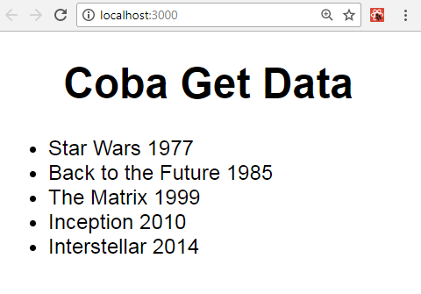
Axios
#5 Render Data

Slide 22
import React, { Component } from 'react';
import axios from 'axios'; class App extends Component {
constructor() {
super();
this.state = {
judul: [],
};
} componentDidMount(){
axios.get('https://facebook.github.io/react-native/movies.json')
.then((ambilData) => {
console.log(ambilData);
this.setState({
judul: ambilData.data.movies,
})
})
};
Axios
#5 Render Data
part 1

Slide 23
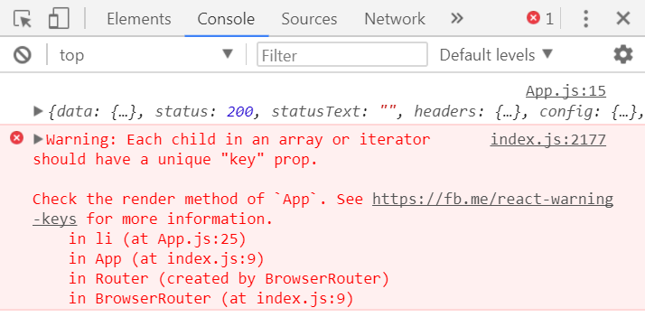
Axios
#5 Render Data
part 2
render() {
const data = this.state.judul.map((item, index)=>{
var fullfilm = [item.title,item.releaseYear].join(" ");
return <li key={index}>{fullfilm}</li>;
})
return (
<div>
<center>
<h1>Coba Get Data</h1>
</center>
<ul>
{ data }
</ul>
</div>
);
}
} export default App;
Tanpa Keys, output program tetap berhasil, namun di Console muncul Warning

Slide 24
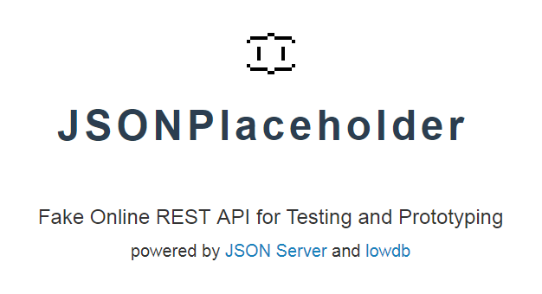
https://jsonplaceholder.typicode.com/
JSONPlaceholder is a free online REST service that you can use whenever you need some fake data.

Slide 25
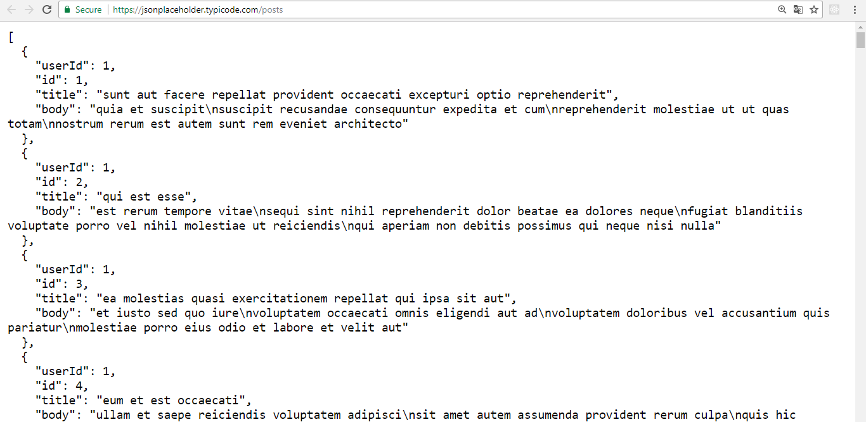
GET all data from
https://jsonplaceholder.typicode.com/posts
Try on Postman!

Slide 26
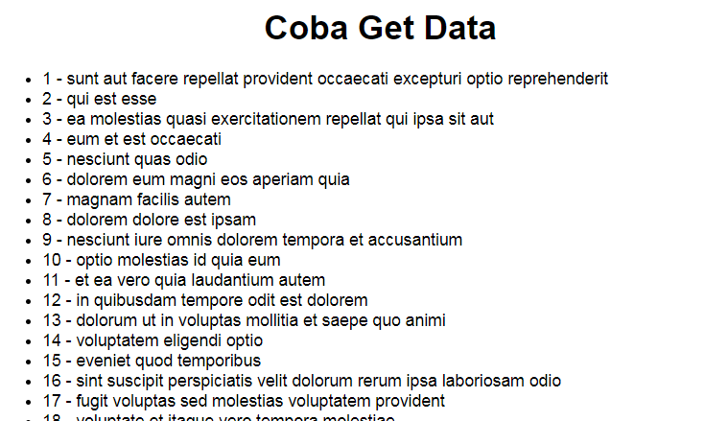
Get all 100 data (id & title) from
https://jsonplaceholder.typicode.com/posts

Slide 27
Part 1
import React, { Component } from 'react';
import axios from 'axios';
class App extends Component {
constructor() {
super();
this.state = {
dataKu: [],
};
}
componentDidMount(){
axios.get('https://jsonplaceholder.typicode.com/posts')
.then((ambilData) => {
console.log(ambilData);
this.setState({
dataKu: ambilData.data,
})
})
};

Slide 28
Part 2
render() {
const data = this.state.dataKu.map((item, index)=>{
var id_title = [item.id,item.title].join(" - ");
return <li key={index}>{id_title}</li>;
})
return (
<div>
<h1>Coba Get Data</h1>
{ data }
</div>
);
}
}
export default App;

Slide 29
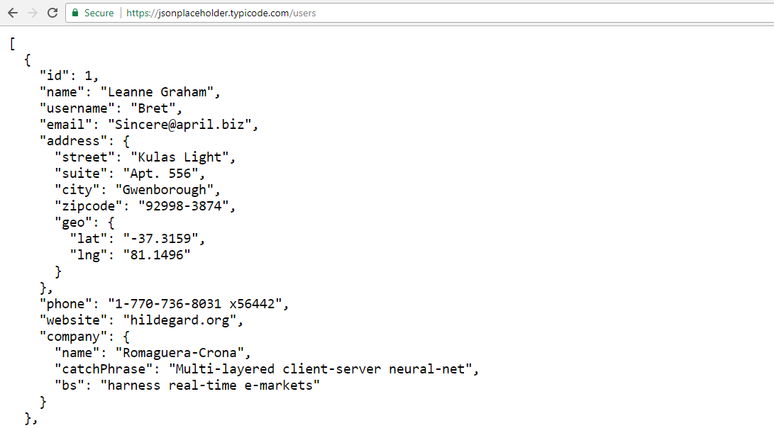
GET all data from
https://jsonplaceholder.typicode.com/users
Try on Postman!

Slide 30
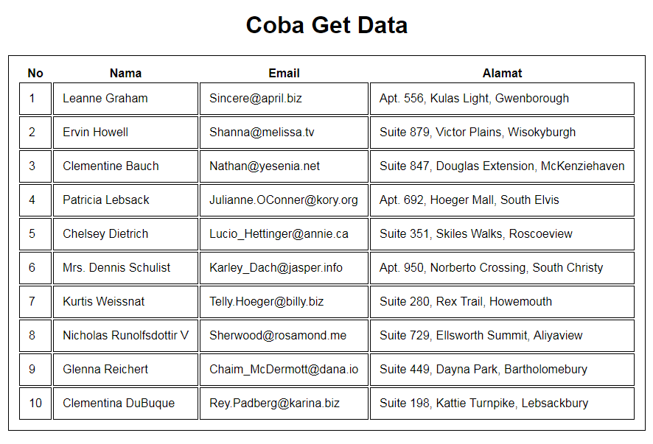
Get all 10 data (id, name, email & address) from
https://jsonplaceholder.typicode.com/users

Slide 31
Part 1
import React, { Component } from 'react';
import axios from 'axios';
class App extends Component {
constructor() {
super();
this.state = {
dataKu: [],
};
}
componentDidMount(){
axios.get('https://jsonplaceholder.typicode.com/users')
.then((ambilData) => {
console.log(ambilData);
this.setState({
dataKu: ambilData.data,
})
})
};

Slide 32
Part 2
render() {
var css = {border:'1px solid black', padding:'12px'}
const data = this.state.dataKu.map((item, index)=>{
var id = item.id;
var name = item.name;
var mail = item.email;
var alamat = [
item.address.suite,
item.address.street,
item.address.city].join(", ");
return <tr style={css} key={index}>
<td style={css}>{id}</td>
<td style={css}>{name}</td>
<td style={css}>{mail}</td>
<td style={css}>{alamat}</td>
</tr>;
})

Slide 33
Part 3
return (
<div><center>
<h1>Coba Get Data</h1>
<table style={css}>
<tbody>
<tr>
<th>No</th>
<th>Nama</th>
<th>Email</th>
<th>Alamat</th>
</tr>
{ data }
</tbody>
</table>
</center></div>
);
}}
export default App;

Slide 34






Free API
Part 1 CoPas only
aladhan.com
alquran.cloud/api
quotesondesign.com
blockchain.info/api/exchange_rates_api
fabian7593.github.io/CountryAPI/
thesportsdb.com/api.php

Slide 35






Free API
Part 2 Auth Key
themoviedb.org
api.nasa.gov
openweathermap.org
wunderground.com
food2fork.com
last.fm

Slide 36



Free API
Indonesian!
mainapi.net
telkomxsight.com
api.jakarta.go.id

Slide 37

Free API
Part 3 Header Key
var url =
'https://developers.zomato.com/api/
v2.1/search?q=kebab';
var config = {
headers: {
'user-key':'your_zomato_api_key'
}
}
axios.get(url, config)
.then((x)=>{
console.log(x.data.restaurants);
})
zomato.com

Slide 38

React
#3 Learn Once, Write Anywhere

